Slide 1

Evolutionary AutoML
Emmanuel KIEFFER / Boonyarit Changaival

Slide 2
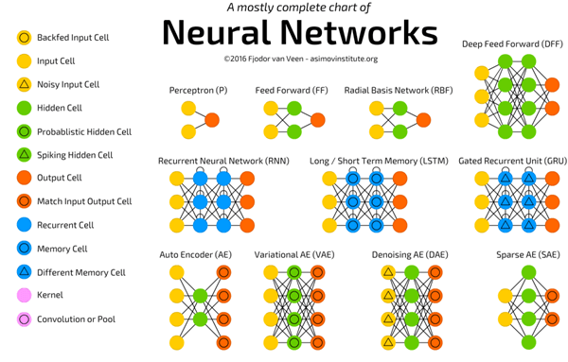
Deep NEURAL NETWORKS
Machine Learning
Supervised Learning approach (but not only)
Many architectures depending on applications
Complex to design
Very often manually designed

Slide 3
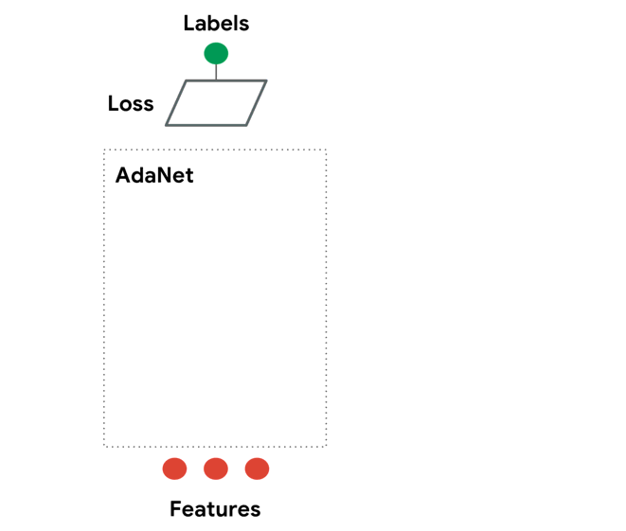
AUTOML
Build automatically architecture
Reduce NN size
Improving prediction accuracy

Slide 4
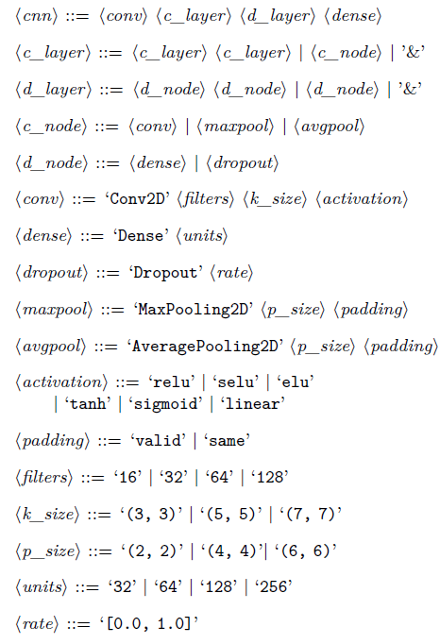
Context
Grammar Evolution = set of constructions rules
Create a grammar to yield a familly of Neural Networks (NNs)
To measure the quality of your grammar:
Evolve NNs obtained from the defined grammar

Slide 5
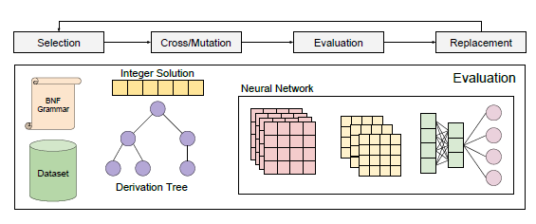
Context
Generate automatically new NNs from the proposed grammar
Compare obtained NNs to the best architectures of the domain
On datasets:
CIFAR-10
CIFAR-100
MNIST , etc …

Slide 6
Project objectives
Provide a state of the art on existing AUTOML approaches
Propose a grammar to evolve CNNs
Design experiments (Optimisation + Training)
Report and analyse the obtained results
If successful, possibility to publish a paper

Slide 7
PREREQUISITES
Students will have to code in Python
Students will need to work with Tensorflow/PonyGE2
Students will use the UL HPC platform and its ressources to train the NNs

Slide 8
BONUS
Kaggle, a subsidiary of Google LLC, is an online community of data scientists and machine learning practitioners
Kaggle allows users to find and publish data sets, explore and build models in a web-based data-science environment
Enter competitions to solve data science challenges.

Slide 9
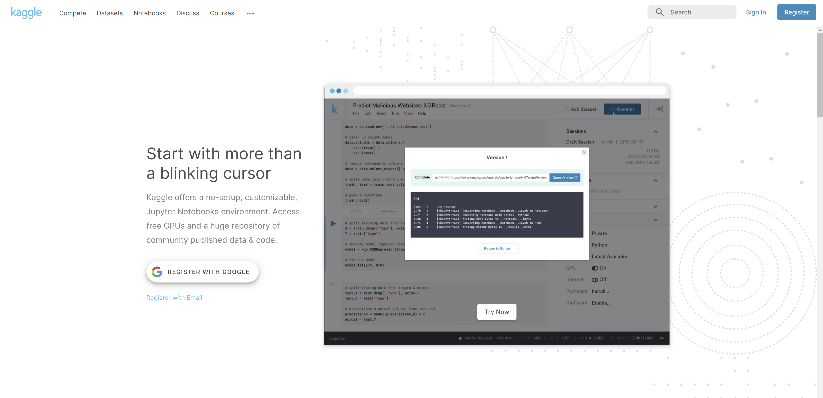
PREREQUISITES
Students will have to code in Python
Students will need to work with Tensorflow/PonyGE2
Students will use the UL HPC platform and its ressources to train the NNs

Slide 10
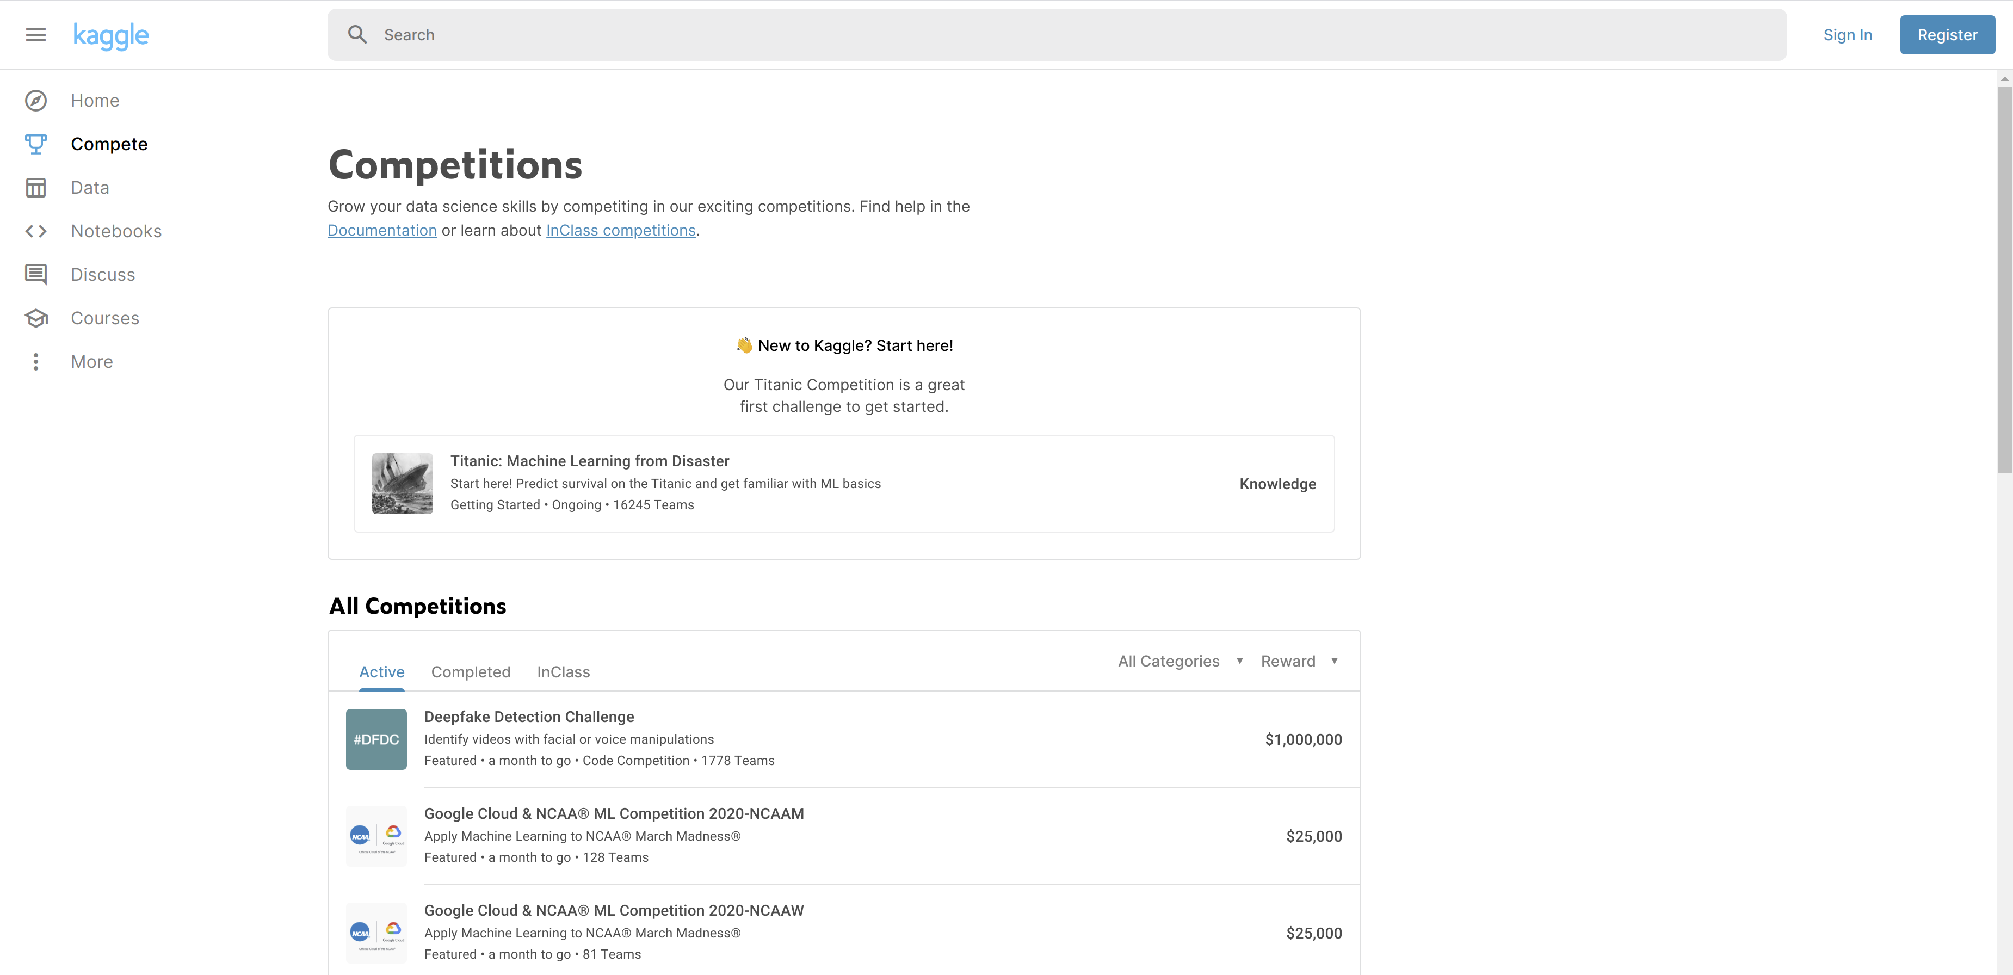

Slide 11
CONTACT
Dr. Emmanuel Kieffer / Dr. Boonyarit Changaival
Faculties: FSTM / SnT
Bureau: MNO, E04 0445-060 / MNO, E04 0445-030
Email: emmanuel.kieffer@uni.lu / boonyarit.changaival@uni.lu

